Slide 1


Slide 2


Welcome to .NET Conf 2021
Scott Hunter and friends
@coolcsh
Notes:
Welcome to .NET Conf 2021! I’m Scott Hunter, VP of Product at Microsoft. I’m excited to share all the great things we’ve built with the open-source community for the .NET 6 release.

Slide 3


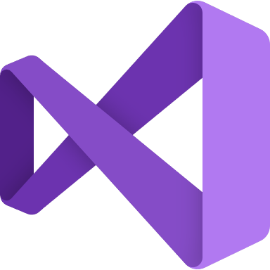





.NET – A unified development platform
ECOSYSTEM
TOOLS
CLOUD
WEB
MOBILE
GAMING
IoT
AI
NuGet
Visual Studio
DESKTOP
Azure
ASP.NET
Blazor
.NET MAUI
WPF
WinForms
.NET MAUI
Xamarin
Unity
ARM32
ARM64
ML.NET
.NET for Apache Spark
GitHub
Visual Studio for Mac
.NET 6
COMMON BASE LIBARIES/APIs
Components, tools, library vendors
Visual Studio Code
INFRASTRUCTURE
RUNTIME COMPONENTS
COMPILERS
LANGUAGES
CLI
Notes:
Cross-platform and open source, .NET is a unified development platform for building anything. You can use the same tools, libraries, languages and runtime to build any application across web, mobile, desktop, AI/ML, data, gaming, and IoT workloads. .NET is a general-purpose programming platform that enables all kinds of application scenarios. Once you learn one, you can easily pick up another. To enable specific app scenarios, app models (or app frameworks) are built on top of the base libraries and runtime to extend what .NET can do. With .NET 6, we’ve unified the SDK, common base libraries, and runtime on which all of these app models sit.
.NET has a vast ecosystem of thousands of library packages you get via NuGet and open-source projects in development on GitHub. There are also hundreds of vendors providing additional components, tools, libraries and services. You can use a broad set of IDEs and editors with .NET including best-in-class tools with Visual Studio, Visual Studio for Mac and the cross-platform editor Visual Studio Code.

Slide 4

.NET ecosystem momentum
5.4M
#1
Top 30
.NET developers
In Visual Studio family
Most Loved Framework (2019, 20, 21)
.NET Core / .NET 5
Highest velocity OSS project since 2017
github.com/dotnet
>6.9K
Community contributors
>21K
Community contributions
.NET 6
Sources: insights.stackoverflow.com/survey/2019#most-loved-dreaded-and-wanted; insights.stackoverflow.com/survey/2020#most-loved-dreaded-and-wanted;
insights.stackoverflow.com/survey/2021#section-most-loved-dreaded-and-wanted-other-frameworks-and-libraries;
www.cncf.io/blog/2021/08/02/update-on-cncf-and-open-source-project-velocity-2020/
Notes:
I’d like to highlight some big accomplishments we’ve made with the .NET community. The .NET ecosystem has seen some significant momentum in the last few years.
There are now 5.4 million monthly active developers in Visual Studio family of tools.
.NET Core / .NET 5 has ranked #1 three years in a row as the most loved framework on the StackOverflow developer survey.
Cloud Native Computing Foundation (CNCF) tracks the highest velocity projects on all of GitHub. They measure this by the rate pull requests and issues come in & how many are accepted. The dotnet repos have been consistently in the top 30 since 2017.
<CLICK>
There are also over 6,900 people outside Microsoft that made over 21,000 contributions! They either filed issues or submitted pull requests to the .NET related repositories for the .NET 6 release.

Slide 5

THANK YOU!
Notes:
A HUGE thank you to ALL the contributors that have made an incredible improvements to the .NET 6 release.
<pause and clap your hands>

Slide 6

.NET 6 Performance
+92%
>10X faster than Node.js
ASP.NET Core web framework
Entity Framework Core Performance
Sources:
https://www.techempower.com/benchmarks/#section=data-r20&hw=ph&test=plaintext
https://www.techempower.com/benchmarks/#section=test&runid=3fc99e53-f60d-428e-9937-e809880d3da2&hw=ph&test=fortune&a=2&o=e
Notes:
We’re always focused on having the best performance. Here you can see the TechEmpower performance comparison with Java and Node.js. Better performance leads to lower compute costs and .NET gets better every release. Many of these improvements were made by the community!
.NET 6’s web framework, ASP.NET Core, is STILL over 10 times faster than Node.js.
We’ve also worked really hard on Entity Framework Core performance:
EF Core performance on .NET 6 has improved a whopping 92% over .NET 5!
Query performance is 36% better than .NET 5
The .NET+ASP.NET+EF stack is the 2nd most highly-performing entry in the “Full ORM” category
(it’s 5th place, but the 1st four are the same). Seb thinks that the first may not qualify for “Full ORM” status, so we may actually be the top runner here.)

Slide 7
.NET 6
Unified common base libraries & SDK
Industry leading performance
Simplified development, easier to get started
New C# 10, F# 6 releases
Apple Silicon (Arm64) support
Long-Term Support Release
get.dot.net/6
Notes:
I’m pleased to announce the general availability of .NET 6.
Talk to big features in bullets
Go get it and start building!

Slide 8



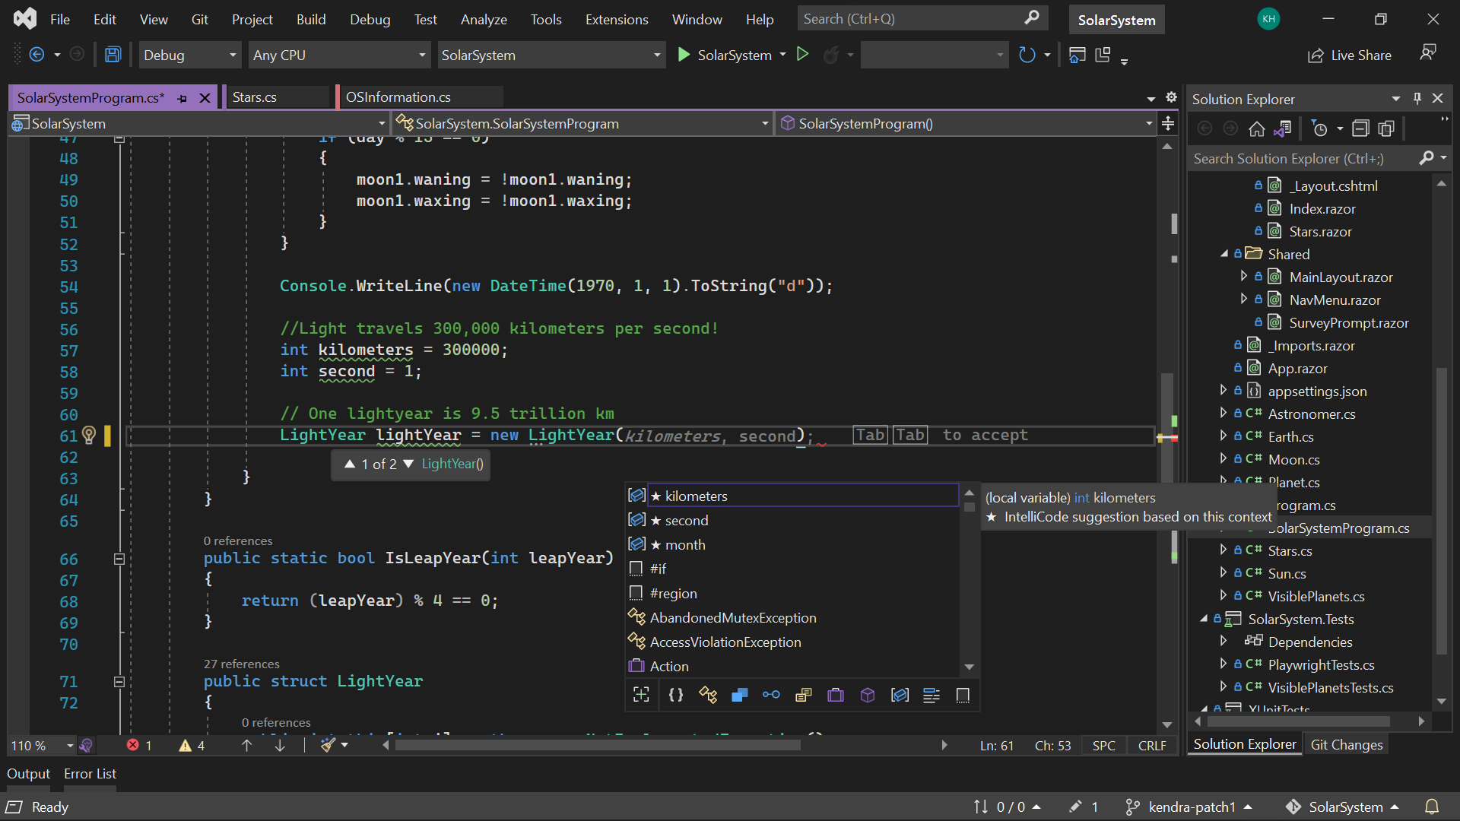
Visual Studio 2022
RELEASED
Modern development
Build innovative, modern apps using .NET 6, GitHub and Azure with integrated tooling
Personal and team productivity
Live Share, Hot reload everywhere, Web live preview, IntelliCode, enhanced debugging and testing tools
Scale to projects of any size
An optimized, modern UI built on 64-bit architecture to support the largest, most complex codebases and workflows
VisualStudio.com/download
Notes:
...and along with .NET 6, we've released the next major version of Visual Studio, VS 2022
VS 2022 is the best IDE for .NET development, with support for the latest project types for:
- cross-platform mobile and desktop apps w/ .NET MAUI
- responsive web UIs with Blazor
- build, run, debug .NET apps in Linux environments with WSL integration
- edit running ASP.NET Framewerk web forms in an updated web designer using web live preview
It helps you stay productive and collaborative with:
- Hot reload (will talk about more in a bit)
- IntelliCode (whole line completions, suggestions for common code refactorings on the fly)
- built-in Git and GitHub integration to clone repos, manage work items and pull requests, and automatically set up CI/CD workflows to GitHub Actions and Azure
And VS 2022 is the first 64-bit version of Visual Studio, so it can take advantage of the full power of your dev box to work on projects of any size and scale.
Go to visualstudio.com and download it today!

Slide 9

.NET Upgrade Assistant
RELEASED
+40K
preview downloads
Reduce time and difficulty modernizing older .NET codebases
Guided, step-by-step experience
Multiple project types supported
C# & VB.NET languages
Supports .NET 6
aka.ms/dotnet-upgrade-assistant
Notes:
To help you move to .NET 6, we’ve released the .NET Upgrade Assistant. It helps you modernize older .NET Framework codebases. It's a command line tool that gives you step-by-step instructions for upgrading to the latest versions of .NET.
We’ve had over 40K downloads of the preview version. Customers like Episerver Optimizely have given us a lot of great feedback through the preview period and now we’re ready to make it generally available.
It now supports C# and VB.NET languages and .NET 6. We’re seeing customers use it very successfully today, so I encourage you to give it a try.
But if you are unable to upgrade at this point that’s OK. We’re shipping an update for the .NET Framework, version 4.8.1. It will add support for ARM64, enhancements to accessibility, and other security and reliability improvements. It will be available as part of Windows Insider Preview builds over the coming months.

Slide 10
Simplified development
Notes:
6 min mark
Now let’s talk about how .NET 6 has made development simpler….

Slide 11
Do more with the CLI
dotnet new <anything>
dotnet watch run
dotnet build –a arm64
More templates, unified SDK
Hot reload via dotnet watch
Native support for Arm64 machines
Single file EXEs for all platforms
Notes:
First, we’re invested heavily in making it easy to get started and do more with the command line interface.
There are more templates available right from the CLI
Hot reload via dotnet watch means you spend less time building and more time coding
.NET 6 is the first release that natively supports Apple Silicon (Arm64) machines and has been similarly improved for Windows Arm64.
Extraction-free single-file apps can be published for Linux, macOS, and Windows (previously only Linux).

Slide 12
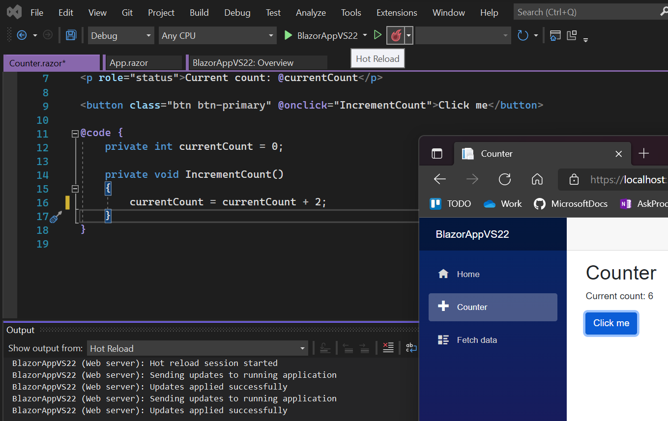
Hot reload everywhere
Speeds up your development, no more F5
Less time restarting, more time coding
Available in CLI & Visual Studio 2022
All project types, all .NET versions 4.6+
Best with .NET 6
Notes:
One of my favorite features is hot reload. And we’ve enabled it everywhere.
Hot Reload is NOT Just for .NET 6 developers, it works on multiple project types and all .NET versions (4.6 and higher) that support edit and continue.
.NET 6 is the most optimized for the best Hot Reload experience, such as Razor editing, CSS Hot Reload, most supported edits, ability to use Hot Reload when starting the app without the debugger (CTRL-F5), hot reload through dotnet watch CLI and Blazor and .NET MAUI project support.

Slide 13
Simplify your code with C# 10
global using Model; // Global usings apply to entire project
// using System; // Implicit usings for each project type
namespace Model; // File-scope namespace, no indentation needed
// Records can be structs as well as classes
public record struct Order(Customer Customer, string Kind, int Items);
public record class Customer(string Name, string Address);
// Lambdas have types
var parse = (string s) => int.Parse(s); // Func<string, int>
Notes:
Now let’s talk about C#! From now on, we’ll release a new major version of C# every year along with each version of .NET. This allows us to ship small features more frequently, getting value to you faster.
C# 10 has a strong focus on simplification.
Global usings are usings that you write once and they apply to your whole project
Project types offer implicit usings so you don’t need to type them anywhere
File-scoped namespaces apply to the whole file; no indentation needed
Records can now be structs
You can say that records are classes instead of leaving it implied
Lambdas that contain enough type information have their own types

Slide 14
Minimal APIs for cloud native apps
Lightweight, single-file, cloud native APIs
Low ceremony, top-level C# programs
Easy to get started
Path to MVC
var app = WebApplication.Create(args);
app.MapGet("/", () => "Hello World!");
app.Run();
Minimal code for minimal apps
Notes:
For .NET 6 we’ve built upon C# top-level programs to provide you with a lightweight way to build ASP.NET web APIs with minimal code.
No usings, no class definitions needed, this is an easy way to build APIs that can immediately take advantage of cloud scale without all the ceremony and setup code of traditional controller-style web APIs.
And when your project starts to get too big, we’ll provide a path move these to ASP.NET MVC controllers. It’s just another option for quickly building APIs that don’t need the all the bells and whistles of controllers and startup classes.

Slide 15

Demo – Simplified development
Console CLI, Minimal APIs, C# 10
Notes:
10 min mark

Slide 16
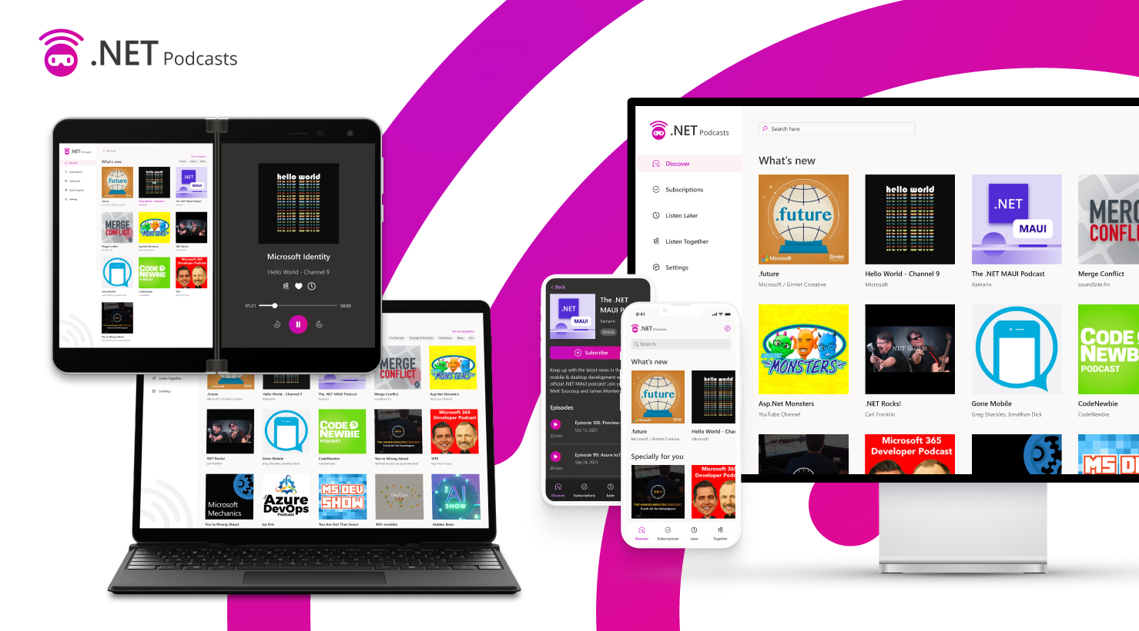
Notes:
Flip to this slide before you head off stage, as Maria starts introducing the app.
We built the .NET podcasts app that span web, mobile, desktop, cloud native backends, and more and we are going to show you all of this today and how .NET 6 enables you do this. Let’s start with the backend API and have Maria talk through how it was built.

Slide 17
Cloud development

Slide 18



Common App Patterns
N-tier (scalable web apps)
Microservices
Frontend
Components
Frontend
Components
Frontend
Components
Frontend
Backend
Data
Service (Orders)
Service (Inventory)
Service (Customers)
Data
Data
Data
Notes:
No matter what type of cloud app you’re building, .NET and Azure have you covered.
A very common pattern is, of course, is N-tier. These apps are typically simpler to build, work well with smaller teams, and are deployed all at once. ASP.NET has many features to help you build beautiful, scalable web apps based on this pattern.
Another common pattern is the microservices pattern. It enables rapid, frequent and reliable delivery of large, complex, highly-scalable applications. Each loosely-coupled service can be independently deployed and owned by separate teams within an organization.

Slide 19



.NET at cloud scale at Microsoft
Azure Active Directory gateway
App Service gateway
Bing.com
Bing XAP (workflow engine)
Dynamics 365 gateway
devblogs.microsoft.com/dotnet/migration-of-bings-workflow-engine-to-net-5/
devblogs.microsoft.com/dotnet/azure-active-directorys-gateway-service-is-on-net-core-3-1/
Notes:
Here are just a few examples of some of the product groups within Microsoft that are using .NET at cloud scale with great performance. And we are seeing significant cost savings running these large-scale services.
<talk to a couple examples really fast. Segue to Dynamics on next slide>

Slide 20
YARP 1.0 – Reverse proxy based on .NET
Cloud-scale performance
Highly extensible & customizable
Supported on .NET Core 3.1, .NET 5 & 6
Open source
Used in production by Microsoft Dynamics 365 & Azure App Service
>100B
requests / month
>7.5PB
petabytes transferred / month
aka.ms/YARP
Stats from Microsoft Dynamics 365 gateway
Notes:
To achieve the scale of the Dynamics 365 gateway service, they have been using YARP. YARP is an example of using .NET within Microsoft for our own services and today I want to announce we are releasing YARP 1.0.
A number of services within Microsoft had their own reverse-proxies, either built themselves or using older technology and they needed to add new features – mainly http/2 so they could support gRPC. However, each of these services does something a little different, so they are not well served by existing off-the shelf solutions.
We saw this as an opportunity:
To solve an internal problem
create a solution that could be used externally
To provide a real-world scenario we can use for exercising end to end usage of .NET
Today YARP is being used by both Dynamics and App Service in production at scale. You can see some of the impressive numbers we are seeing with Dynamics.
The YARP library is on Nuget, and the code is open-source on Github. We look forward to seeing what you can build with it.

Slide 21


.NET 6 support in Azure today
Azure App Service Fully managed hosting for web apps,
REST APIs, and mobile back ends
All regions
Both Windows and Linux
Azure Static Web Apps
Streamlined full-stack development from
source code to global high availability
Blazor WebAssembly with AOT support
.NET 6 Azure Functions APIs
Azure Functions Event-driven serverless compute
Azure Functions runtime 4.0
Both in-process and isolated models
Notes:
I’m extremely happy to say we have .NET 6 supported on Azure today!
Azure App Service support for .NET 6 is available now in ALL regions, for BOTH Linux and Windows.
Azure Static Web Apps now supports full-stack .NET 6 apps with Blazor WebAssembly and Azure Functions.
Azure Functions support for .NET 6 is now available in Azure Functions runtime 4.0. Both the in-process and isolated models are supported in .NET 6.0 Azure Functions.

Slide 22
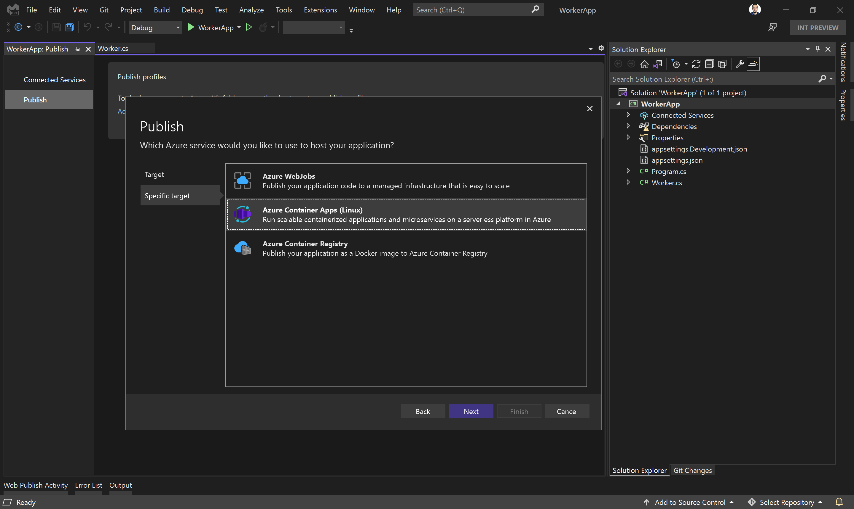




Public preview
Azure Container Apps
Serverless containers for microservices
ASP.NET web APIs & minimal APIs
Build modern apps on open source
Worker Service for background services
Focus on apps, not infrastructure
Publish from Visual Studio 2022
Seamlessly upgrade to Kubernetes
Kubernetes
KEDA
Dapr
Envoy
Notes:
Azure Container Apps was announced last week at Ignite and they aim to make building microservice-based applications a lot easier.
Container Apps is the only serverless container solution offering a combination of built-in HTTP-based auto-scale (including scale to zero), and event-driven auto-scale to run containers that may be processing messages from queues, streams, or databases. Container Apps supports microservice architectures built with containers using *any* language, framework, or runtime. Container Apps provides a streamlined code-to-cloud pipeline using GitHub Actions.
Container Apps abstracts away Kubernetes and lets you focus on building apps instead of managing infrastructure. It lets you perform modern application lifecycle tasks such as application upgrades, traffic shifting, and versioning ready-to-run for teams of every skillset.
<CLICK>
Container Apps are perfect for microservices built with .NET too. Whether you are building ASP.NET web APIs, minimal APIs, or using the Worker Service template for background services, Container Apps can run them seamlessly. You’ll also be able to deploy them to Container Apps with Visual Studio 2022. The tooling is available today in the VS2022 preview channel with the release of 17.1 Preview 1.

Slide 23

Demo – Cloud development
.NET 6 Worker Services, Azure Container Apps
Notes:
30 min mark

Slide 24
Modern client development

Slide 25



Blazor – full stack web apps with .NET
Blazor Server
Blazor WebAssembly
Blazor
Blazor
DOM
SignalR
.NET
Razor Components
DOM
.NET
Razor Components
WebAssembly
Full access to server capabilities
Fast to startup
Code never leaves the server
Supports older browsers & thin clients
Requires persistent connection
Higher UI latency
Runs fully client-side
No required server component
Host as a static site
Can execute offline
Larger download size
Slower runtime performance
Blazor WebAssembly ahead-of-time (AOT) compilation
Smaller Blazor WebAssembly app download size
Error boundaries
Razor component type inference & generic type constraints
Dynamic components
Blazor state persistence during prerendering
.NET 6
Notes:
Blazor lets you write full stack web apps with C# instead of JavaScript and it has become a very popular. In fact, it’s one of the fastest growing workloads in .NET today. It has supported two models since spring 2020, Blazor Server and Blazor WebAssembly which runs completely in the browser. Blazor has a shared component model across the server and the client browser. Depending on your application’s needs, you can choose the right model for you.
<CLICK>
We’ve released event more features for your Blazor web apps in .NET 6 and we’ll show a demo of those in a few minutes. Some include:
You can now ahead-of-time compile your Blazor WebAssembly apps to WebAssembly for significantly improved runtime performance.
The download size of Blazor WebAssembly apps is also smaller even though we’ve added support for over 500 new APIs in .NET 6.
When prerendering Blazor components from the server you can now persist the state of those components so it can be reused on the client

Slide 26
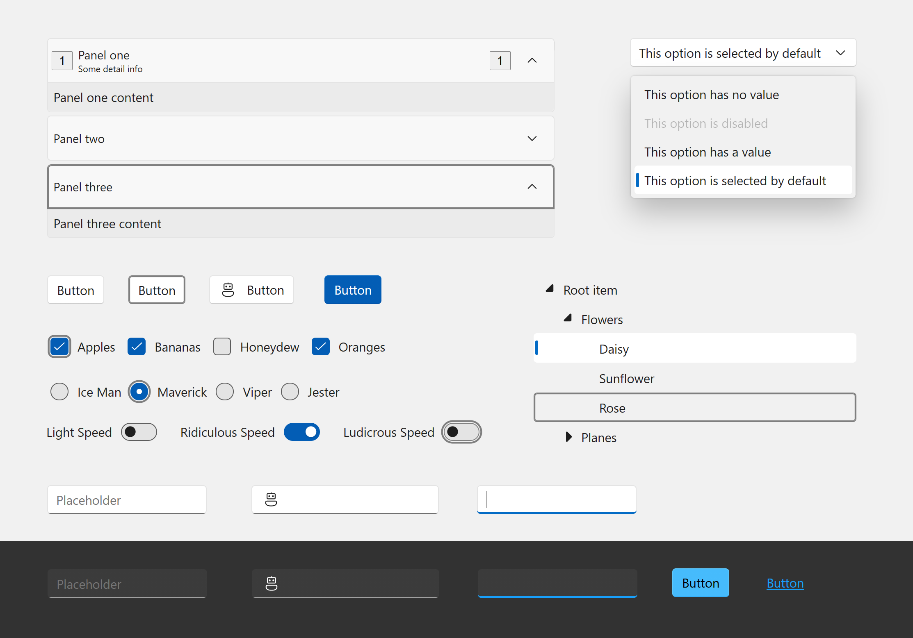
Blazor Fluent UI Components
40+ Blazor components
Fully accessible with light, dark, and high contrast modes
Default styles match the latest Windows 11 Fluent visuals
Integration with web, Windows, Teams, Office, and more
aka.ms/blazor-fluent-ui
Notes:
I’m also happy to announce that the Blazor Fluent UI components have released with over 40 new controls. Fully accessible and styles matching the latest Window 11 fluent visuals.
Check them out and use them in your Blazor apps.

Slide 27




.NET Multi-platform App UI
.NET 6
Cross-platform, native UI
Single project system, single codebase
Deploy to multiple devices, mobile & desktop
General availability early next year
.NET MAUI
WinUI
Mac Catalyst
iOS
Android
macOS
iOS
github.com/dotnet/maui
Notes:
Next I want to talk about .NET MAUI.
.NET MAUI is the evolution of Xamarin.Forms designed to help you deliver high-performance, cross-platform, native desktop & mobile apps all from a single codebase.
.NET MAUI under the hood uses technologies out there today for building native apps on Windows with WinUI, Mac Catalyst for macOS, and of course, iOS and Android. .NET MAUI abstracts all those frameworks into a single framework built on .NET 6.
.NET MAUI on Windows supports WinUI allowing these apps to use all the newest native features on supported versions of Windows 10.
That means you can build all these apps for any device from a single codebase and project system. Instead of learning different stacks and languages for each, you can use one language, one set of libraries, and one UI stack for all of them.
It will release early spring next year. You can watch the progress and help contribute on GitHub in the /dotnet/maui repo.

Slide 28
Hybrid apps with Blazor & .NET MAUI
Blazor
Reuse UI components across native and web
Built on top of .NET Multi-platform App UI
Native app container & embedded controls
General availability early next year
Can use native app
container & controls
.NET MAUI
macOS
iOS
Notes:
We first supported Blazor on the server, then in the browser with WebAssembly. Now we’re extending it again so you can write Blazor hybrid apps. This means you can create hybrid client apps, which combine web and native UI together in a single native client application. It is primarily targeted at web developers that want to provide rich client and offline experiences for their users.
Blazor hybrid apps is built on top of .NET MAUI.
It relies on that UI stack for a native application container and native controls should you want to use them. Blazor desktop apps have full access to the machine. You can do things like call native API's, access the file system, write multi-threaded applications – all with the high-performance and optimal memory consumption you get with .NET. You can't do this with pure web technologies.
These scenarios will also be supported when .NET MAUI releases early next year.

Slide 29
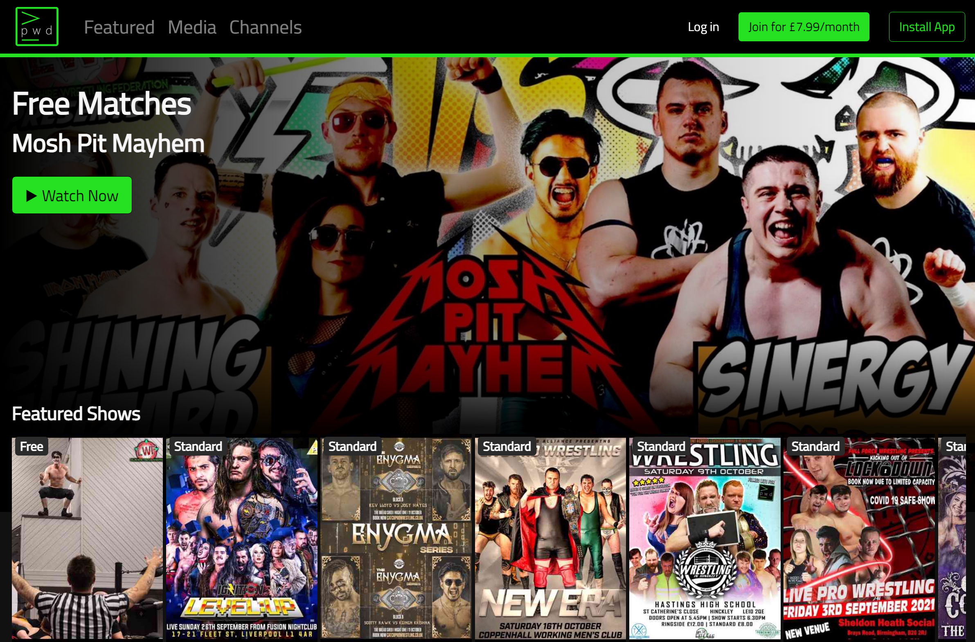
Powered4.tv
“We want to create the ‘Netflix of wrestling’.
We’ve been running the live site with .NET 6 release candidates and have been very happy with the performance and scale.
As a small business we are cost sensitive. .NET and Azure enables a small start-up like us to compete in the market, and scale as we grow.”
- Steve Peirce, Co-founder & CTO
5.6M
video impressions
37K
total viewing hours
65
countries
Notes:
Let’s take a look at some customers building production apps with Blazor and .NET MAUI today.
Powered4.tv is a startup media company based in the UK serving 65 countries world-wide. They provide independent, on-demand wresting content to their viewers. They use Blazor WebAssembly for their frontend and ASP.NET Core on Azure and are very happy with the productivity, performance and scale. In fact, they’ve been using .NET 6 release candidates for their live site for a while. Check out Steve’s talk later in the conference!

Slide 30

Pronto Pay
“We chose to go into production with .NET MAUI because as a startup, we need to move fast and want be on the cutting edge of tech.
We love the simplicity of a single code-base and the usability on iOS, Android, macOS, and Windows.
And with the ease of deployment built into Visual Studio, we had a tool that allowed us to build a product that was dependable for our customers, yet nimble enough to continue growth with a startup team.”
- Jeff Price, Founder & CEO
Technologies used
Azure, .NET MAUI, Blazor, GitHub, Visual Studio
Notes:
Pronto Pay is another startup based in Houston Texas that chose to go into production with .NET MAUI because they needed to move fast. They love the simplicity of a single code-base that they can build to target multiple devices and the productivity of Visual Studio.

Slide 31
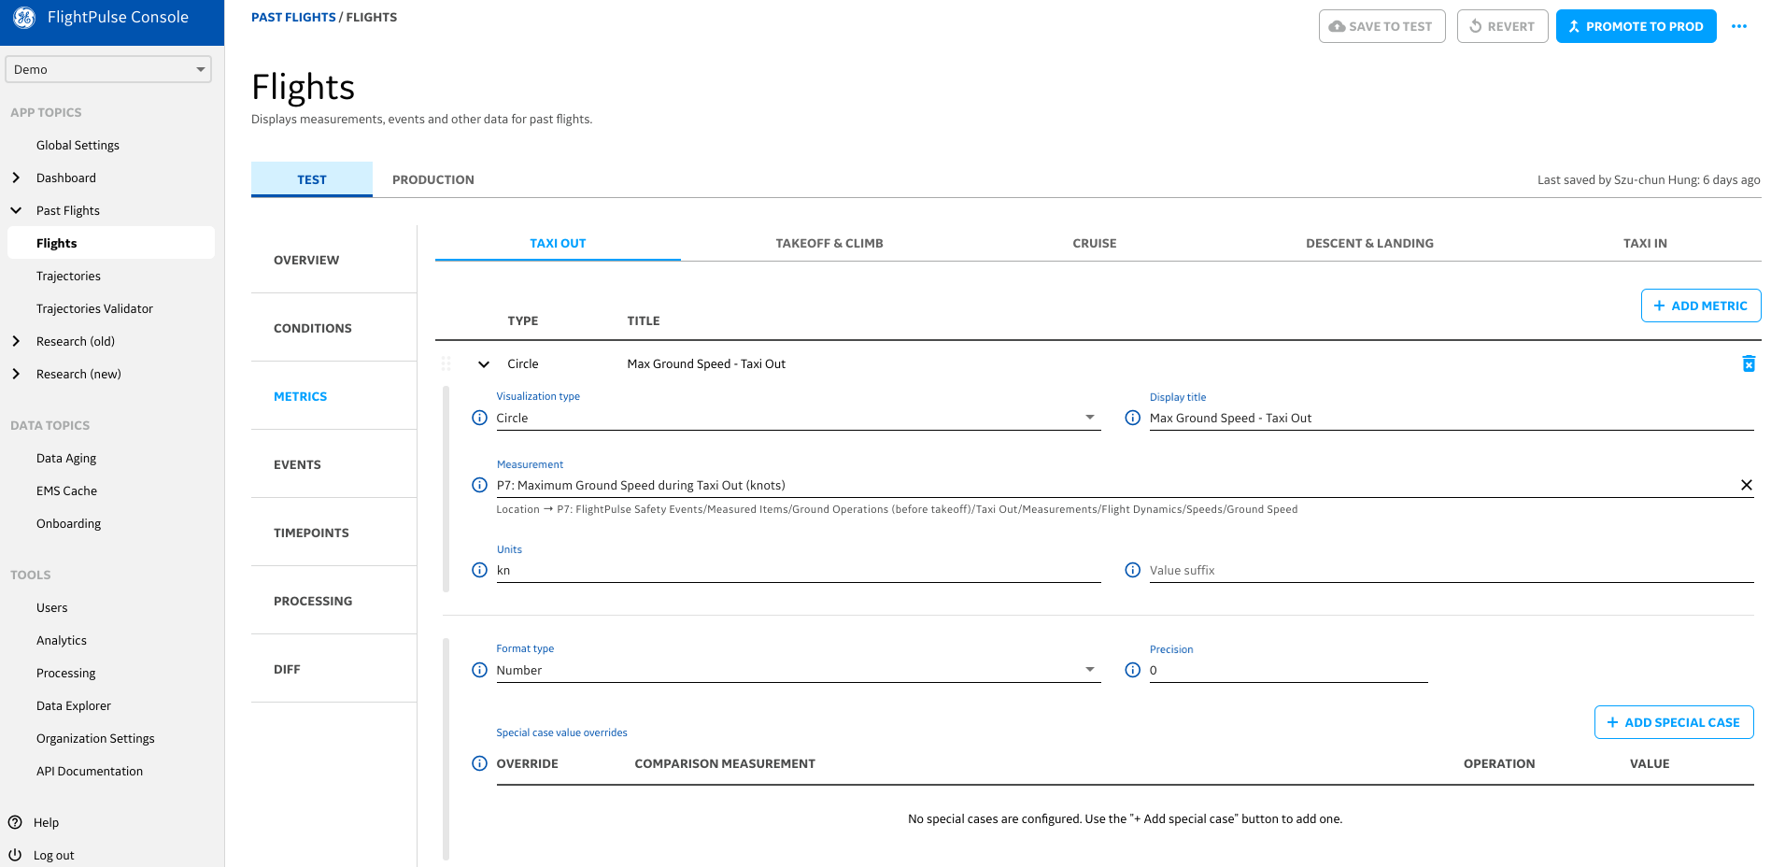

GE Digital
GE Digital used Blazor to build their FlightPulse Config Console App, used by flight safety and efficiency departments to configure and aggregate the data pilots see.
“We were able to build the app faster and work more efficiently given the componentization that we were able to use out of the box with Blazor.
It worked a lot more seamlessly than some of the stuff we’d done previously in Angular.”
- Ken Kozman, Principal Architect at GE
Technologies used
Azure, ASP.NET Core, Blazor, Visual Studio Code
Notes:
GE Digital’s Aviation group developed FlightPulse, an app that puts data and analytics in the hands of more than 3,000 Qantas pilots to help them improve safety and efficiency on every flight.
The Config Console is built with Blazor and they were able to work faster, share more code, and it was a lot more seamless development experience than they had previously had with Angular.
Let’s roll the video.

Slide 32
.NET MAUI Preview 10
Windows App SDK dependencies fully included
More controls including CollectionView, IndicatorView, VerticalTextAlignment, TextTransform, and more
Performance improvements for Android startup
Layout improvements and bug fixes
Available with Visual Studio 17.1 Preview 1: VisualStudio.com/preview

Slide 33

Demo – Modern client development
Blazor & .NET MAUI

Slide 34

Get started today!
Download .NET 6
Download Visual Studio 2022
Use the Upgrade Assistant
Try out the MAUI preview
Have a great conference!
get.dot.net/6
VisualStudio.com/download
aka.ms/dotnet-upgrade-assistant
VisualStudio.com/preview
Ask questions on Twitter #dotNETConf

